Slide 1
EXPLORING TRADITIONAL ML
Machine learning (ML) is a subdomain of artificial intelligence (AI) that focuses on developing systems that learn—or improve performance—based on the data they ingest. Artificial intelligence is a broad word that refers to systems or machines that resemble human intelligence. Machine learning and AI are frequently discussed together, and the terms are occasionally used interchangeably, although they do not signify the same thing. A crucial distinction is that, while all machine learning is AI, not all AI is machine learning.
What is Machine Learning?
Machine Learning is the field of study that gives computers the capability to learn without being explicitly programmed. ML is one of the most exciting technologies that one would have ever come across. As it is evident from the name, it gives the computer that makes it more similar to humans: The ability to learn. Machine learning is actively being used today, perhaps in many more places than one would expect.

Slide 2
TYPES OF MACHINE LEARNING
Supervised machine learning will learn the relationship between input and output through labelled training data, so is used to classify new data using these learned patterns or in predicting outputs.
Unsupervised machine learning on the other hand is useful in finding underlying patterns and relationships within unlabeled, raw data. This makes it particularly useful for exploratory data analysis, segmenting or clustering of datasets, or projects to understand how data features connect to other features for automated recommendation systems.
Examples of supervised machine learning include:
Classification, identifying input data as part of a learned group.
Regression, predicting outcomes from continuously changing data.
Examples of unsupervised machine learning include:
Clustering, grouping together data points with similar data.
Association, understanding how certain data features connect with other features.
Dimensionality Reduction

Slide 3
Popular Machine Learning Applications and Examples
1. Social Media Features
Social media platforms use machine learning algorithms and approaches to create some attractive and excellent features. For instance, Facebook notices and records your activities, chats, likes, and comments, and the time you spend on specific kinds of posts. Machine learning learns from your own experience and makes friends and page suggestions for your profile.
2. Product Recommendations
Product recommendation is one of the most popular and known applications of machine learning. Product recommendation is one of the stark features of almost every e-commerce website today, which is an advanced application of machine learning techniques. Using machine learning and AI, websites track your behavior based on your previous purchases, searching patterns, and cart history, and then make product recommendations.
3. Image Recognition
Image recognition, which is an approach for cataloging and detecting a feature or an object in the digital image, is one of the most significant and notable machine learning and AI techniques. This technique is being adopted for further analysis, such as pattern recognition, face detection, and face recognition.
4. Sentiment Analysis
Sentiment analysis is one of the most necessary applications of machine learning. Sentiment analysis is a real-time machine learning application that determines the emotion or opinion of the speaker or the writer. For instance, if someone has written a review or email (or any form of a document), a sentiment analyzer will instantly find out the actual thought and tone of the text. This sentiment analysis application can be used to analyze a review based website, decision-making applications, etc.

Slide 4
5. Automating Employee Access Control
Organizations are actively implementing machine learning algorithms to determine the level of access employees would need in various areas, depending on their job profiles. This is one of the coolest applications of machine learning.
6. Marine Wildlife Preservation
Machine learning algorithms are used to develop behavior models for endangered cetaceans and other marine species, helping scientists regulate and monitor their populations.
7. Regulating Healthcare Efficiency and Medical Services
Significant healthcare sectors are actively looking at using machine learning algorithms to manage better. They predict the waiting times of patients in the emergency waiting rooms across various departments of hospitals. The models use vital factors that help define the algorithm, details of staff at various times of day, records of patients, and complete logs of department chats and the layout of emergency rooms. Machine learning algorithms also come to play when detecting a disease, therapy planning, and prediction of the disease situation. This is one of the most necessary machine learning applications.
8. Predict Potential Heart Failure
An algorithm designed to scan a doctor’s free-form e-notes and identify patterns in a patient’s cardiovascular history is making waves in medicine. Instead of a physician digging through multiple health records to arrive at a sound diagnosis, redundancy is now reduced with computers making an analysis based on available information.
9. Banking Domain
Banks are now using the latest advanced technology machine learning has to offer to help prevent fraud and protect accounts from hackers. The algorithms determine what factors to consider to create a filter to keep harm at bay. Various sites that are unauthentic will be automatically filtered out and restricted from initiating transactions.

Slide 5
10. Language Translation
One of the most common machine learning applications is language translation. Machine learning plays a significant role in the translation of one language to another. We are amazed at how websites can translate from one language to another effortlessly and give contextual meaning as well. The technology behind the translation tool is called ‘machine translation.’ It has enabled people to interact with others from all around the world; without it, life would not be as easy as it is now. It has provided confidence to travelers and business associates to safely venture into foreign lands with the conviction that language will no longer be a barrier.
Your model will need to be taught what you want it to learn. Feeding relevant back data will help the machine draw patterns and act accordingly. It is imperative to provide relevant data and feed files to help the machine learn what is expected. In this case, with machine learning, the results you strive for depend on the contents of the files that are being recorded.

Slide 6
LINEAR REGRESSION THEORY AND INTUITION
Linear regression is one of the most fundamental algorithms in machine learning. Its primary goal is to model the relationship between a dependent variable (the one you're trying to predict) and one or more independent variables (the features or predictors). It's called linear because it models this relationship as a straight line.
Imagine you're a shop owner, and you want to predict sales based on advertising. The idea is that sales will increase as you spend more on advertising. Linear regression helps you find the best possible line that represents this relationship.
Linear Regression Equation
For a simple linear regression (one independent variable), the relationship is modeled by a line:
y=mx + b
Where:
y is the dependent variable (the one you're predicting).
x is the independent variable (the predictor or feature).
b is the intercept (the value of y when x=0).
m​ is the slope of the line (how much y changes when x changes).

Slide 7
Ordinary Least Squares (OLS)
Residual Sum of Squares (RSS)
Cost Function
Gradient Descent

Slide 8
REGRESSION EVALUATION METRIC
Mean Absolute Error(MAE)
MAE is a very simple metric which calculates the absolute difference between actual and predicted values.
To better understand, let’s take an example you have input data and output data and use Linear Regression, which draws a best-fit line.
Now you have to find the MAE of your model which is basically a mistake made by the model known as an error. Now find the difference between the actual value and predicted value that is an absolute error but we have to find the mean absolute of the complete dataset.
so, sum all the errors and divide them by a total number of observations And this is MAE. And we aim to get a minimum MAE because this is a loss.

Slide 9
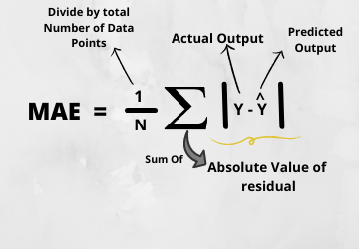

Slide 10
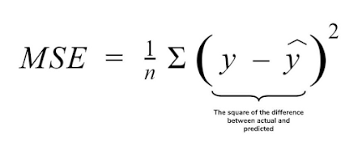
Mean Squared Error(MSE)
MSE is a most used and very simple metric with a little bit of change in mean absolute error. Mean squared error states that finding the squared difference between actual and predicted value.
So, above we are finding the absolute difference and here we are finding the squared difference.
What actually the MSE represents? It represents the squared distance between actual and predicted values. we perform squared to avoid the cancellation of negative terms and it is the benefit of MSE.

Slide 11
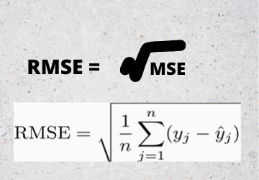
Root Mean Squared Error(RMSE)
As RMSE is clear by the name itself, that it is a simple square root of mean squared error.
.

Slide 12
Bias Variance Trade-Off
Regularization
Feature Scaling
Grid Search
Feature Engineering

Slide 13

CROSS-VALIDATION
Cross-validation is a technique for evaluating machine learning models by training them on different subsets of the available data and testing them on the remaining data. This approach helps to detect overfitting, which occurs when a model performs well on training data but fails to generalize to new, unseen data.

Slide 14
